Slide 1
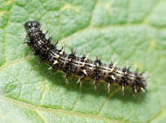
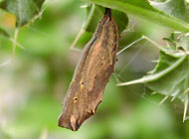
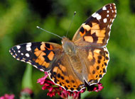
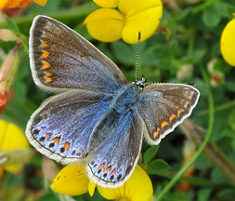
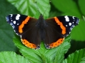
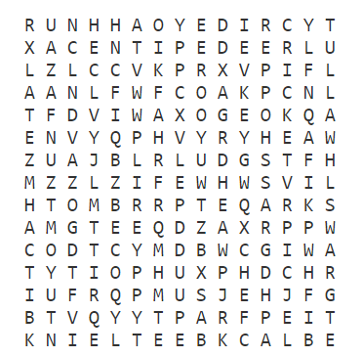
All Aflutter
Painted Lady Butterflies are very common this year. They can be found in any stage of their life cycle. See if you can find one of each of these different stages
and tick the boxes:
 Caterpillar
 Chrysalis
 Butterfly
The number of Common Blue Butterflies had dropped, but we can now see many more of them. Can you spot one on your journey?
Red Admirals are one of the most common in the UK. Can you see any hiding in the trees?
A Bugs Life
Can you find all of the bugs in the wordsearch and then spot them in real life?
ANT
BLACKBEETLE
BUTTERFLY
CATERPILLAR
CENTIPEDE
CRICKET
FLY
GRASSHOPPER
LADYBIRD
MOTH
SPIDER

Slide 2
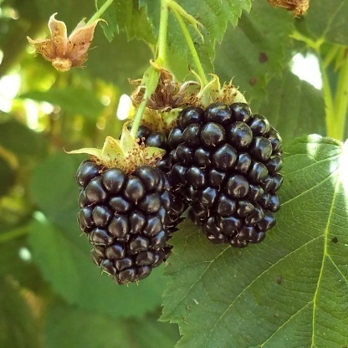
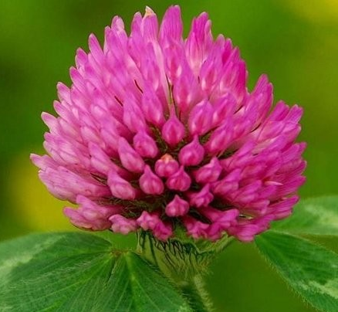
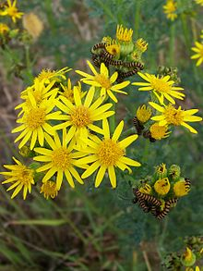
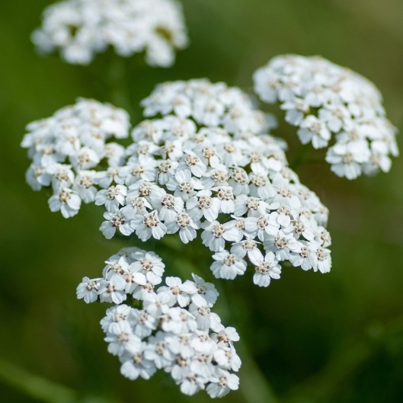
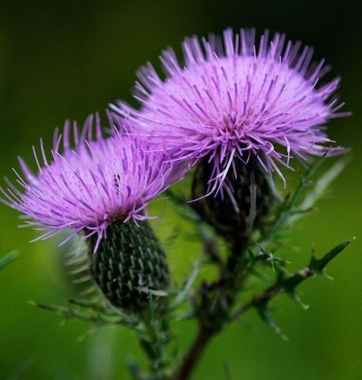
Flora and Fauna
Look out for the tallest tree on your daily walk. When you have found it draw a picture in the box of one of the leaves.
Look at the pictures below and see if you can spot all of the different flowers in real life.
Blackberries
Red clover
Cow Parsley
Ragwort
Achillea
Purple thistle

